Slide 1
24MAT120
S2 P and M

Slide 2
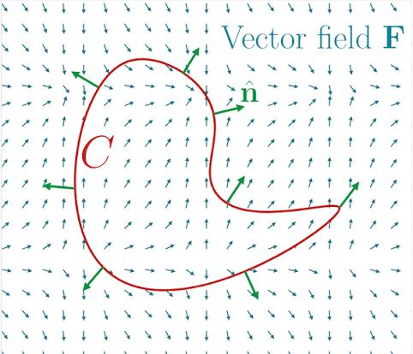
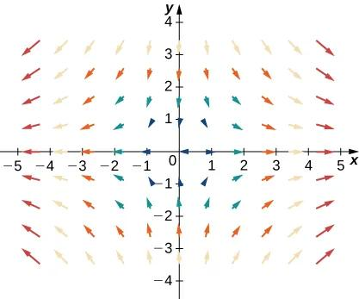
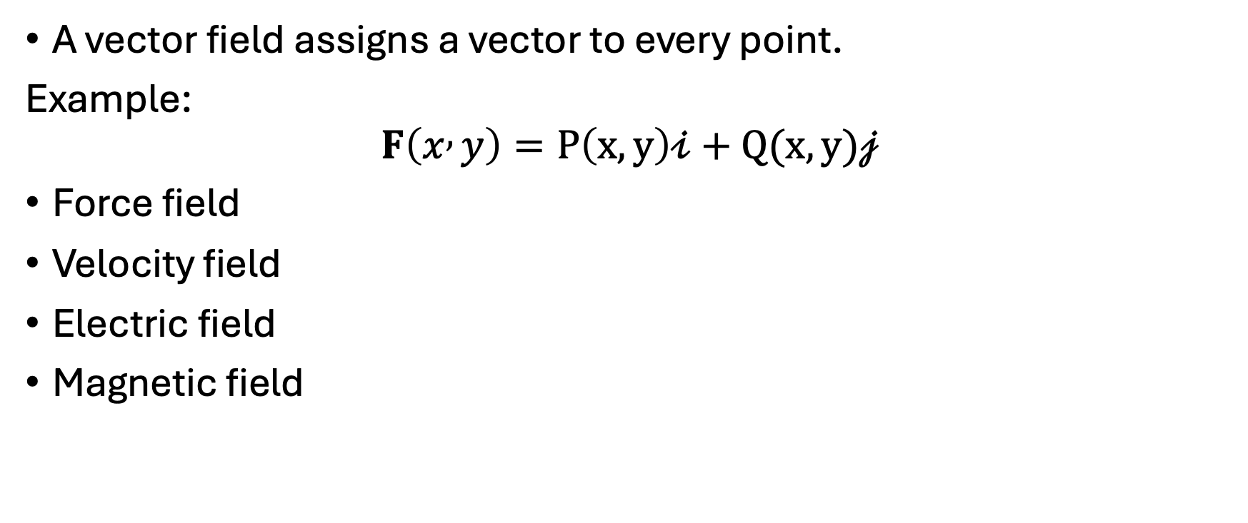
Vector Field
A vector field assigns a vector to every point.
Example:
$$F\left(x , y\right)=P\left(x,y\right)𝒾+Q(x,y)𝒿$$
Force field
Velocity field
Electric field
Magnetic field

Slide 3
Generally, a vector field is a function that assigns a vector to each point in its domain.
A vector field on a three-dimensional domain in space might have a formula like
F(x, y, z)= M(x, y, z)i + N(x, y, z)j + P(x, y, z)k.
The field is continuous if the component functions M, N, and P are continuous; it is differentiable if each of the component functions is differentiable.
The formula for a field of two-dimensional vectors could look like
F(x, y)= M(x, y)i + N(x, y)j.

Slide 4
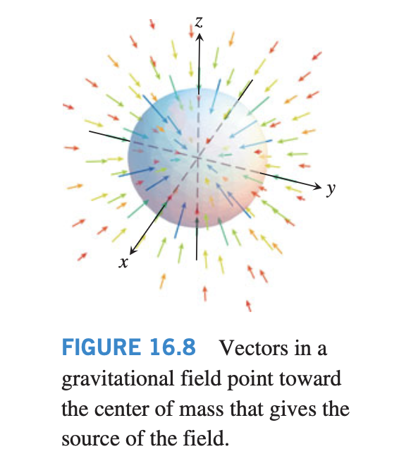
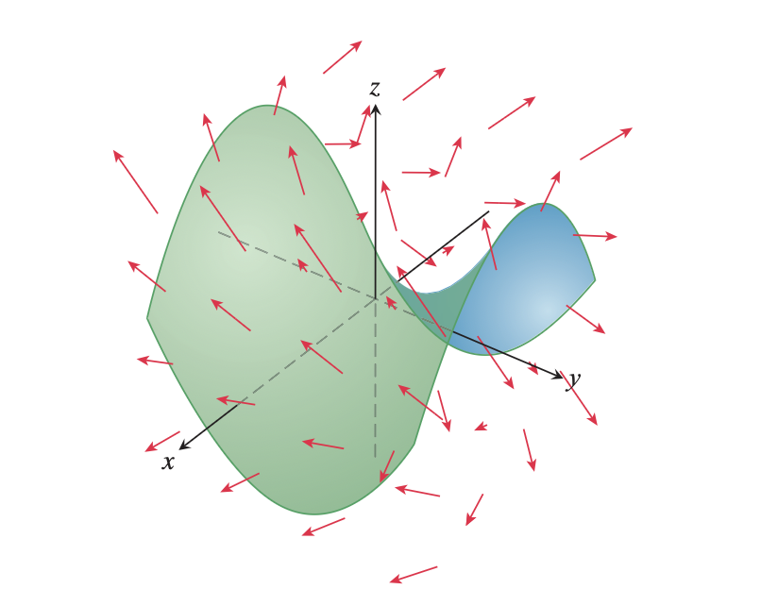
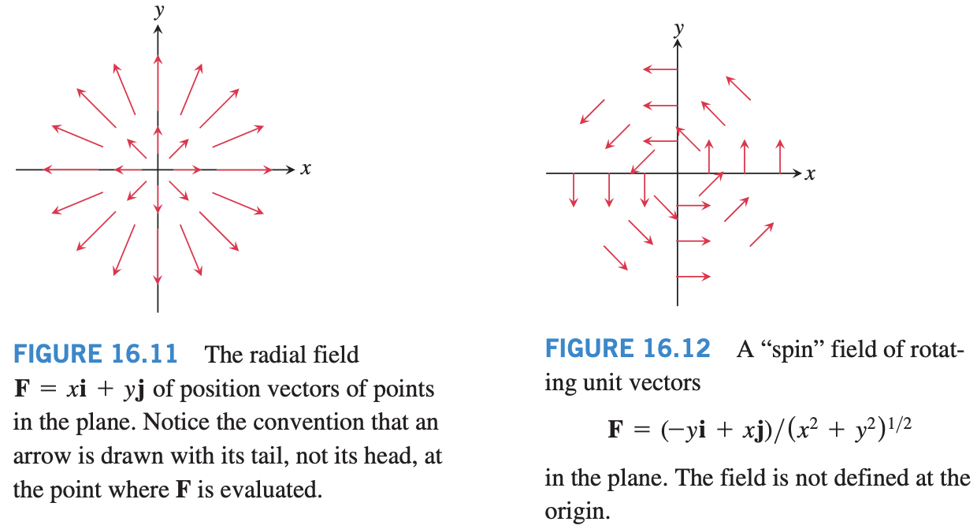

Slide 5
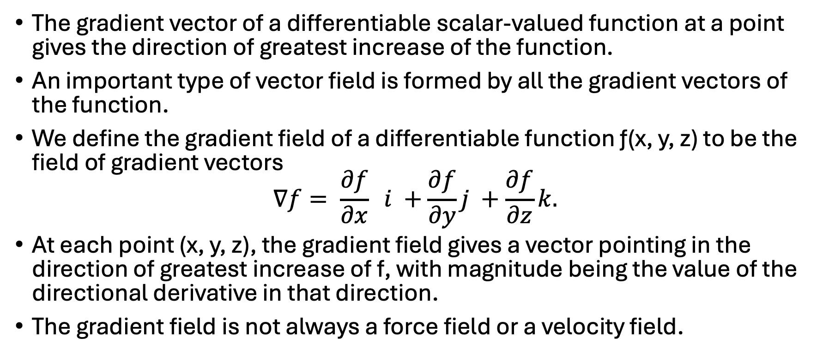
Gradient Fields
The gradient vector of a differentiable scalar-valued function at a point gives the direction of greatest increase of the function.
An important type of vector field is formed by all the gradient vectors of the function.
We define the gradient field of a differentiable function ƒ(x, y, z) to be the field of gradient vectors
$$∇f= \frac{∂f}{∂x} i +\frac{∂f}{∂y}j +\frac{∂f}{∂z}k.$$
At each point (x, y, z), the gradient field gives a vector pointing in the direction of greatest increase of f, with magnitude being the value of the directional derivative in that direction.
The gradient field is not always a force field or a velocity field.

Slide 6
Vector Line Integrals
We defined the line integral of a scalar function ƒ(x, y, z) over a path C.
We turn our attention now to the idea of a line integral of a vector field F along the curve C.
Such line integrals have important applications in studying fluid flows, and electrical or gravitational fields.

Slide 7
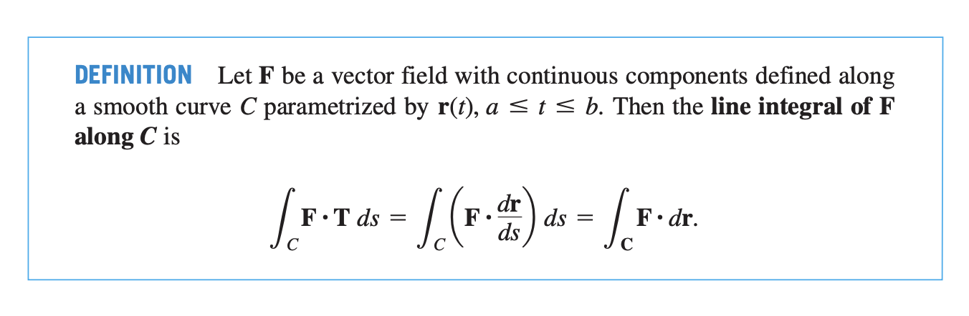

Slide 8
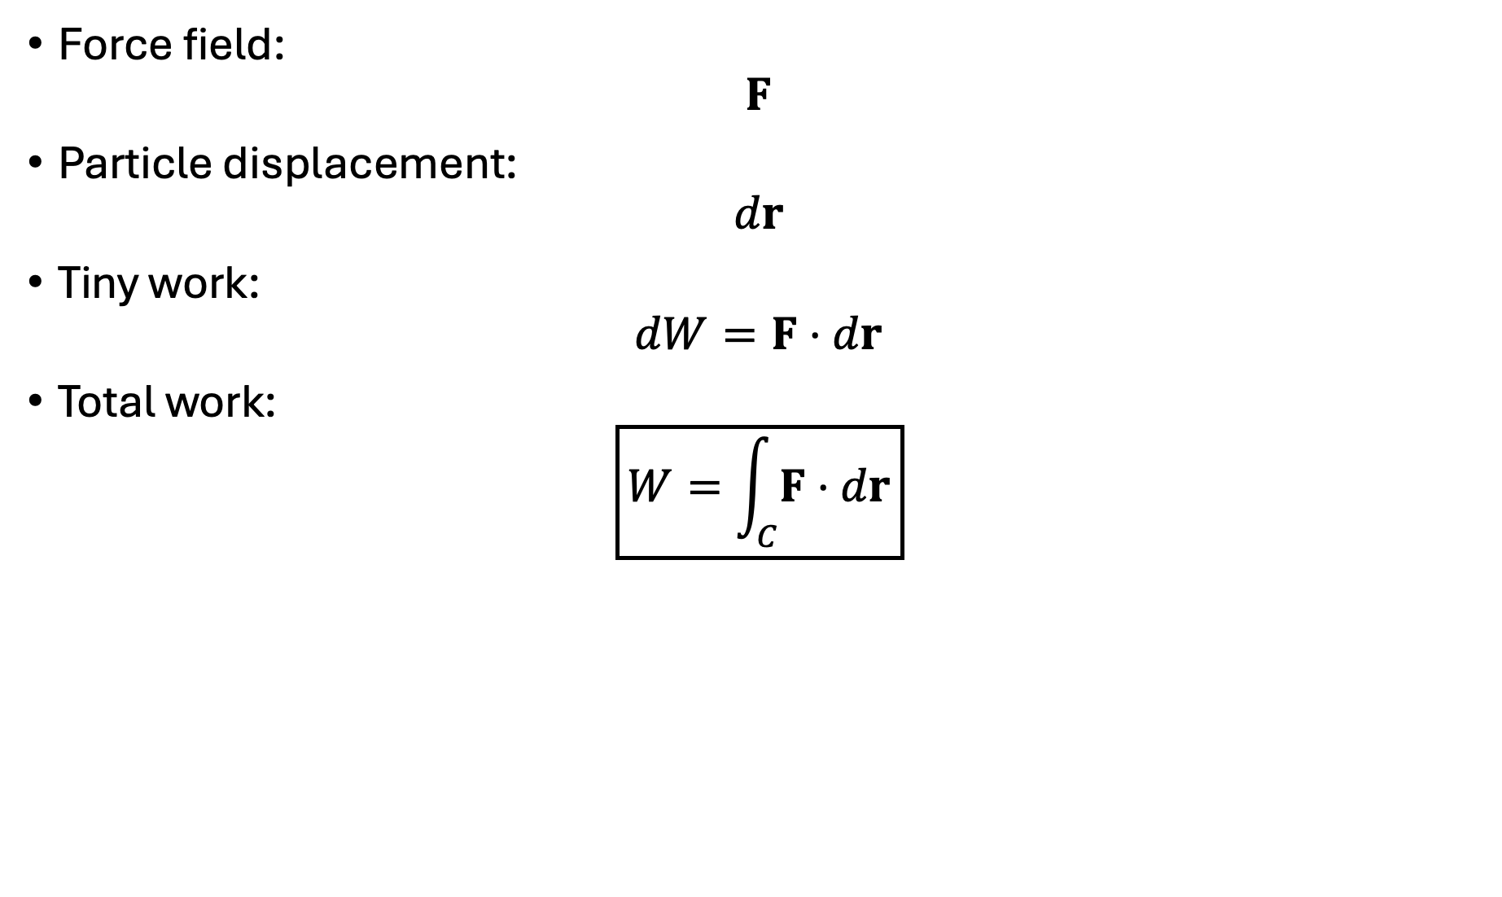
Force field:
$$F$$
Particle displacement:
$$dr$$
Tiny work:
$$dW=F⋅dr$$
Total work:
$$\boxed{W=\int_{C}{F}⋅dr}$$

Slide 9
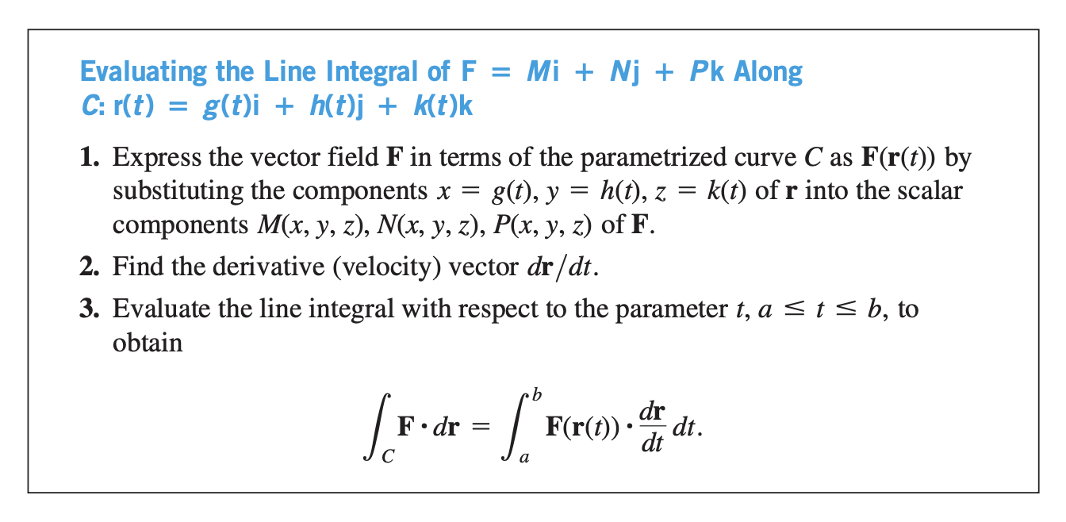

Slide 10
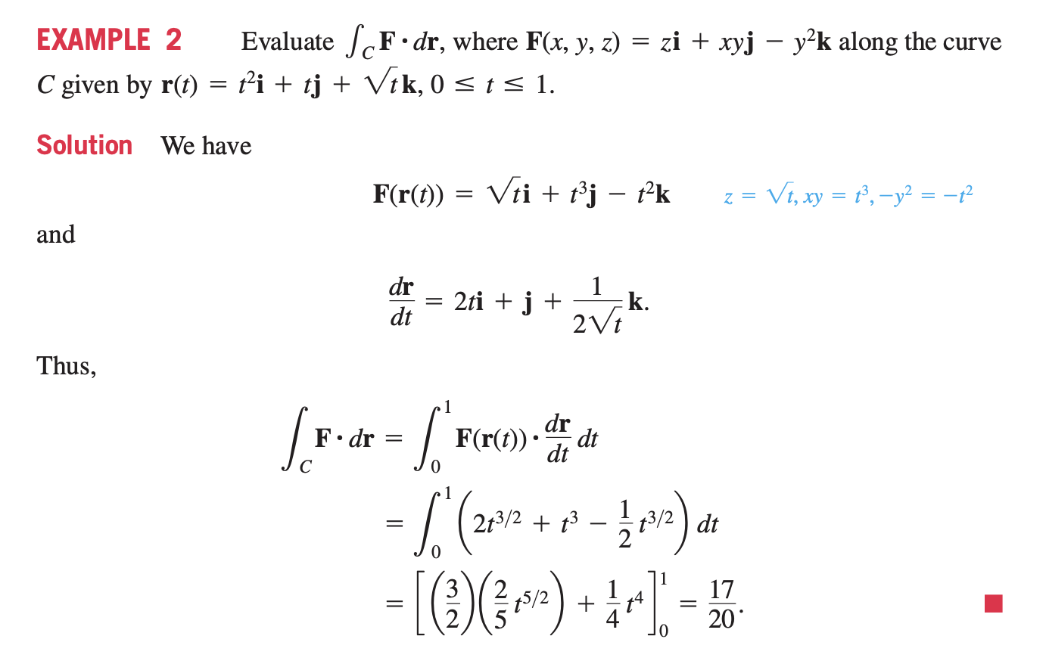

Slide 11
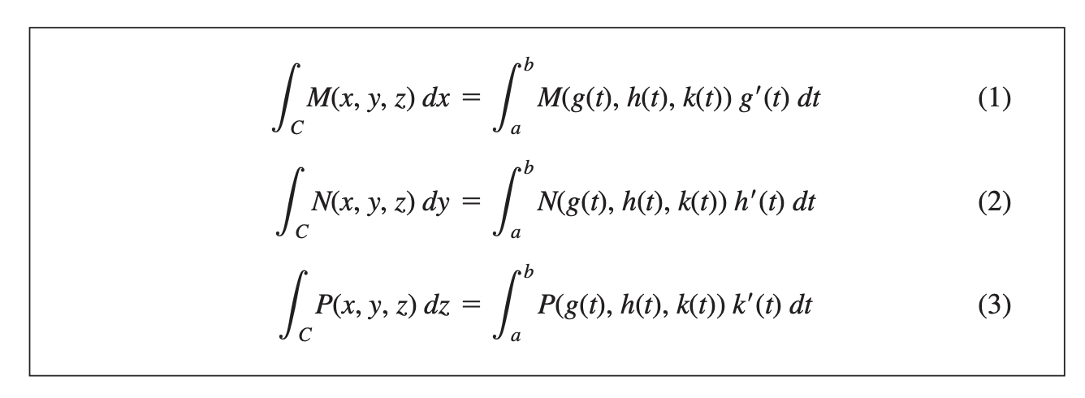
Line Integrals with Respect to dx, dy, or dz
When analysing forces or flows, it is often useful to consider each component direction separately.
In such situations we want a line integral of a scalar function with respect to one of the coordinates.

Slide 12
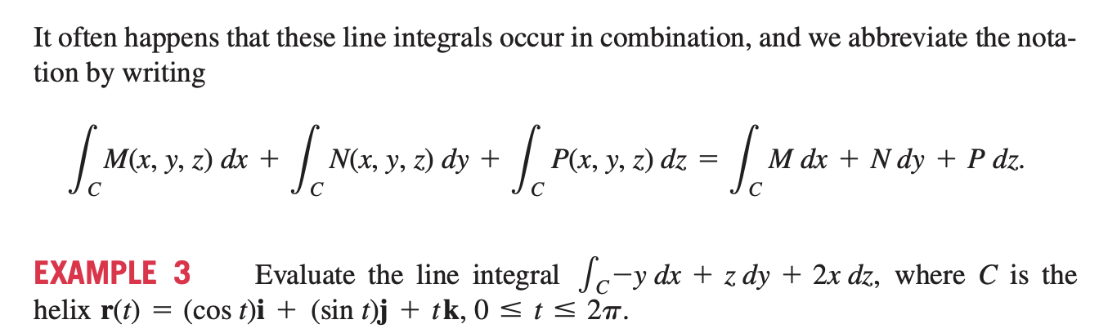

Slide 13
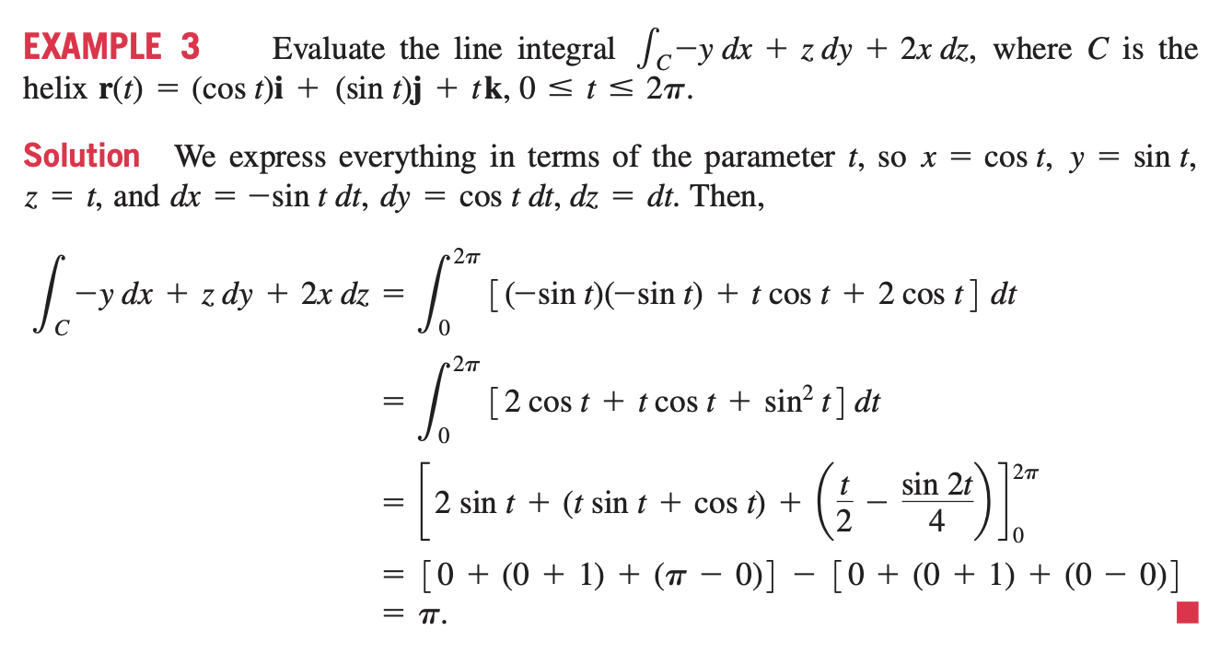

Slide 14
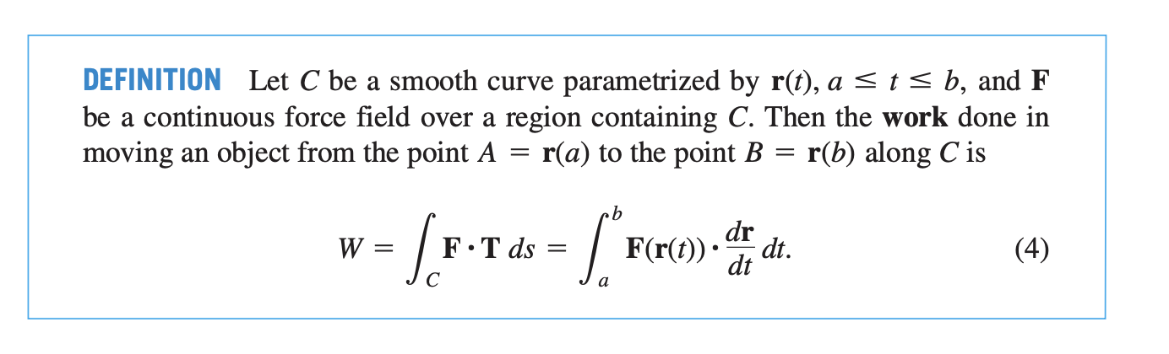

Slide 15
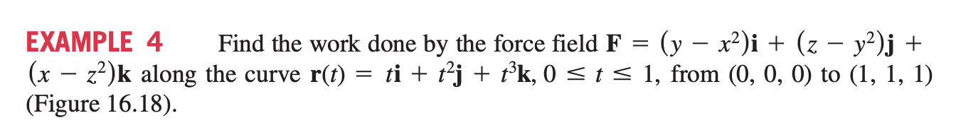
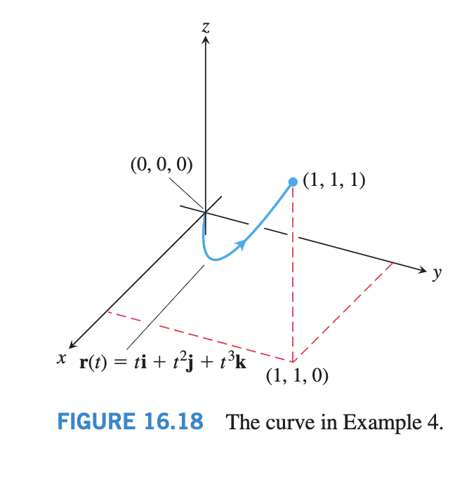

Slide 16
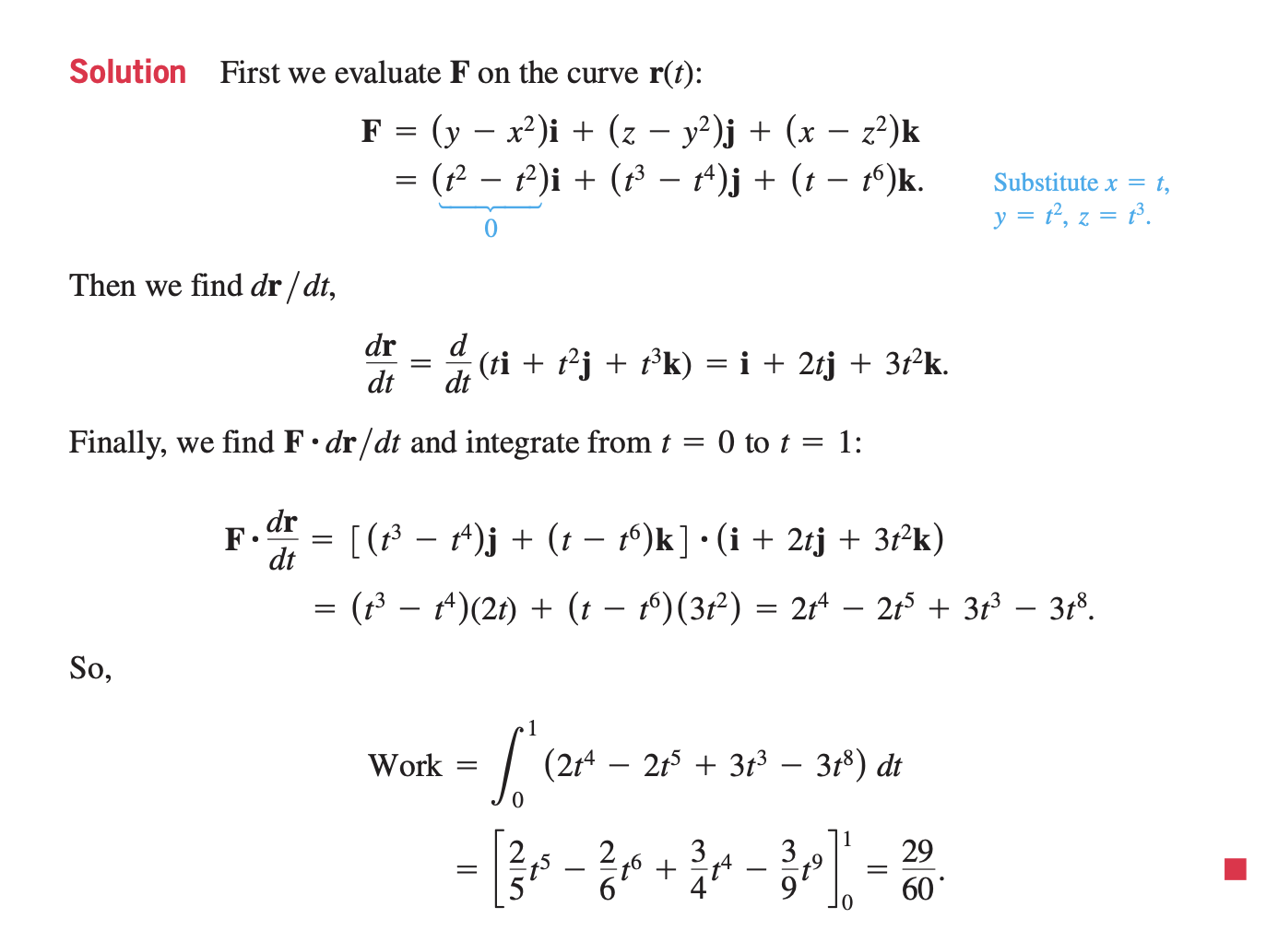

Slide 17
